Slide 1
Preference Neural Network
Ayman Ahmed Elgharabawy
Prof. CT Lin.

Slide 2

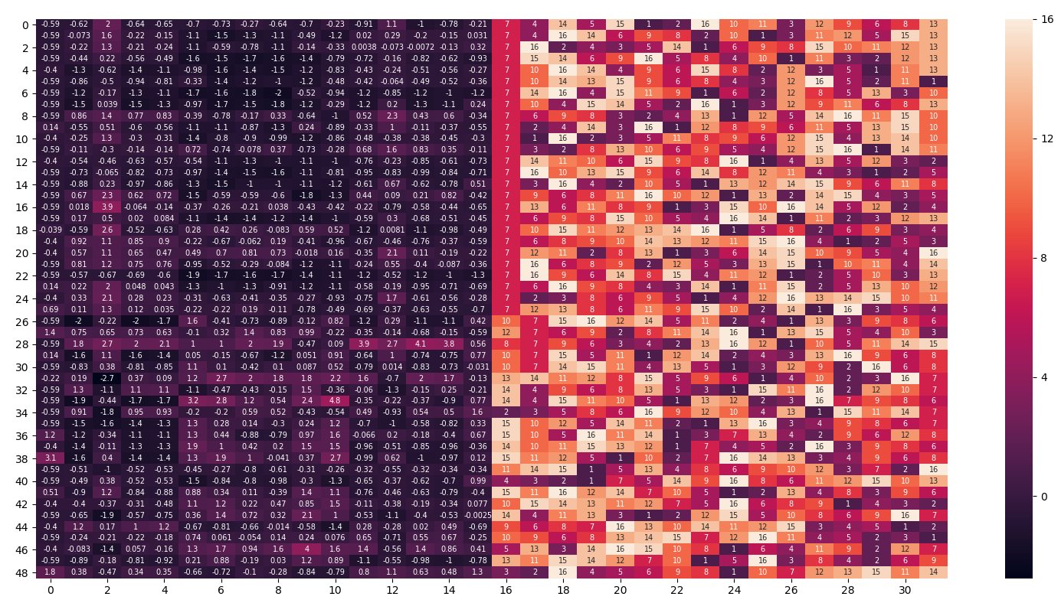
What is Multi-label ranking
Domain of preference learning.
Multi-label ranking the predicting of strict
relations between labels.
Multi-label ranking problem
Features
Labels
1 >2> 3> 4 > 5 > 6>..

Slide 3


Research Objectives
1- Predicting new type of preference relations.
Indifference label ranking
(subgroups ranking)
Incomparable relation

Slide 4
Research gaps of current Multi-labels ranking methods.
2-Filling research gaps of multi-label ranking performance.
Variation in ranking results. Current Multi-labels approaches use decision trees, probability methods and clustering methods which don’t minimize the ranking error function.
Probabilities models measure label by score not by the ranking distance.
For Neural Network Based approach, they use activation functions for pairwise ranking which are mainly used for classification.
(Enhance the classification doesn’t mean enhance the ranking)

Slide 5
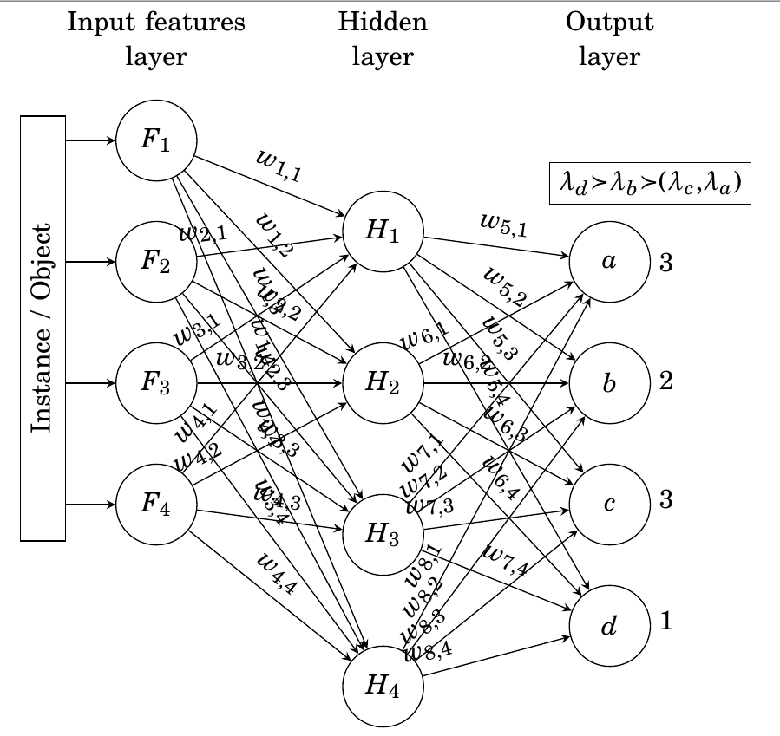
Preference Neural network (PNN)
PNN is fully connected feed forward neural network to predict preference values.
PNN uses stairstep activation function to rank labels.
Represents all labels space as output neurons. Thus we can rank them all at once which reduce calculation cost.
Use Ranking error for learning stopping criteria
Simple and novel approach.

Slide 6
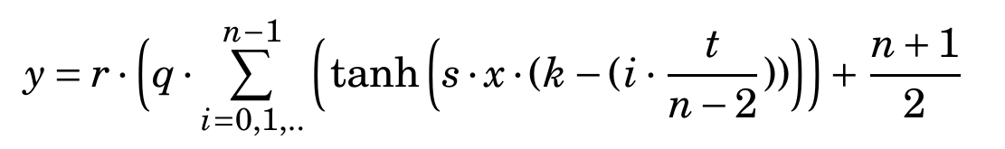
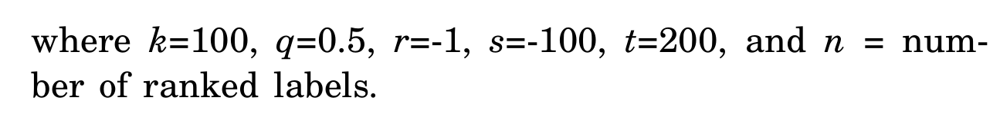
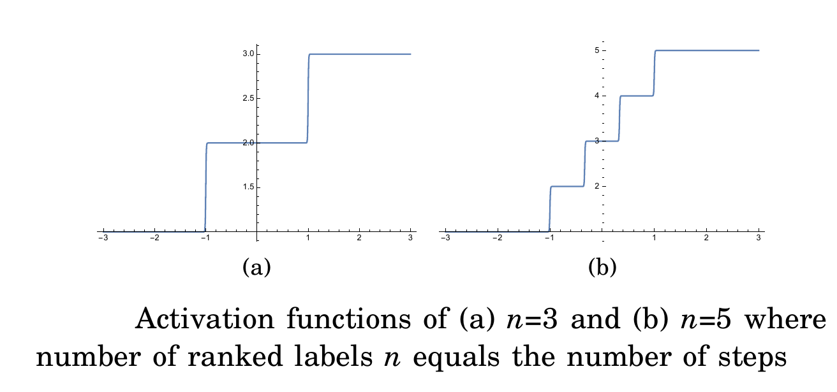
PNN Stair step Activation function

Slide 7
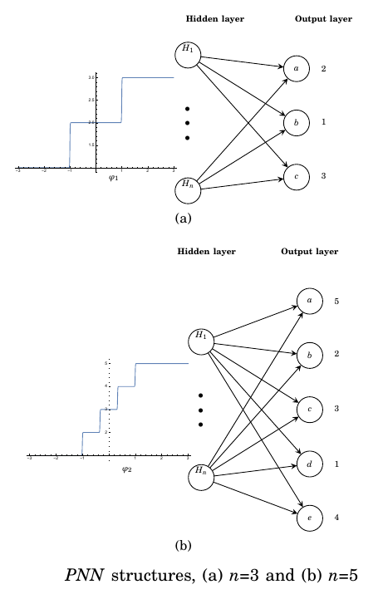
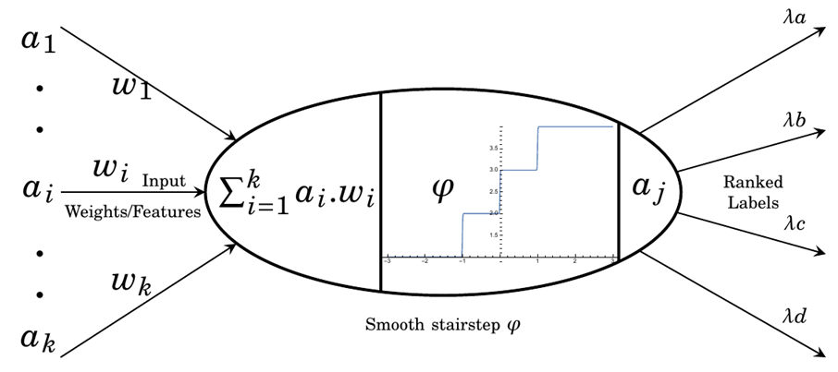
PNN Structure
Preference Neuron

Slide 8
PNN Architecture

Slide 9
Ranking Example: (1)
Input Layer
Hidden Layer
Output Layer
x1
H1
a
x2
H2
b
x3
H3
c
x4
H4
d

Slide 10
Ranking Example: (2)
Initialize weights :
Input Layer
Hidden Layer
Output Layer
x1
H1
a
W1,1
W5,1
W2,1
W5,2
W6,1
W3,1
W7,1
W8,1
W 5,4
x2
W1,2
H2
W 5,3
b
W2,2
W6,2
W3,2
W6,3
W7,2
W6,4
W8,2
W1,3
x3
W2,3
H3
c
W3,3
W7,3
W4,3
W8,3
W2,4
W7,4
W1,4
W4,4
x3
H3
c
W4,4
W8,4

Slide 11
Ranking Example: Iteration 1-FF
Features
Labels
0.1 – 0.3 – 0.5 – 0.7
3 - 2 - 3 - 1
1
0.5 – 0.3 – 0.2 – 0.1
4 - 3 -2-1
Input Layer
Hidden Layer
Output Layer
Output
Expected
0.1
0.16
2.9
1.19
0.1
0.1
4
3
0.1
0.1
0.1
0.1
0.1
0.1
0.3
0.2
0.32
3
0.2
2.38
0.2
4
2
0.2
0.2
0.2
0.2
0.2
0.3
0.3
0.3
0.3
0.5
0.48
3
3.57
3
0.3
0.3
4
0.3
0.3
0.4
0.4
0.4
0.4
0.4
0.4
0.7
0.64
3
4.76
1
0.4
0.4
4

Slide 12
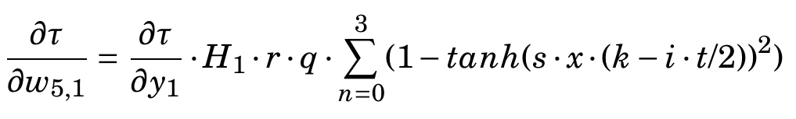
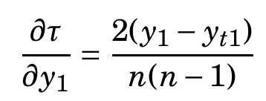
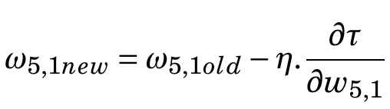
Ranking Example: Iteration 1-BP
Features
Labels
0.1 – 0.3 – 0.5 – 0.7
3 - 2 - 3 - 1
1
0.5 – 0.3 – 0.2 – 0.1
4 - 3 -2-1
Input Layer
Hidden Layer
Output Layer
Output
Expected
0.1
0.16
2.9
1.19
0.21
0.15
4
3
0.321
0.231
0.1
0.3
0.6
0.21
0.3
0.32
0.32
3
0.32
2.38
0.2
4
2
0.2
0.42
0.42
0.2
0.2
0.3
0.3
0.53
0.3
0.5
0.48
3
3.57
3
0.31
0.53
4
0.3
0.3
0.26
0.21
0.64
0.4
0.24
0.24
0.7
0.64
3
4.76
1
0.32
0.14
4
= 0.05

Slide 13
Ranking Example: Iteration 1-FF
Features
Labels
0.1 – 0.3 – 0.5 – 0.7
3 - 2 - 3 - 1
2
0.5 – 0.3 – 0.2 – 0.1
4 - 3 -2-1
Input Layer
Hidden Layer
Output Layer
Output
Expected
0.1
0.16
2.9
1.19
0.21
0.15
3.8
3
0.321
0.231
0.1
0.3
0.6
0.21
0.3
0.32
0.32
3
0.32
2.38
0.2
3.6
2
0.2
0.42
0.42
0.2
0.2
0.3
0.3
0.53
0.3
0.5
0.48
3
3.57
0.31
0.53
3.9
3
0.3
0.3
0.26
0.21
0.64
0.4
0.24
0.24
0.7
0.64
3
4.76
1
0.32
0.14
2.7

Slide 14
Ranking Example: Iteration 1-BP
Features
Labels
0.1 – 0.3 – 0.5 – 0.7
3 - 2 - 3 - 1
2
0.5 – 0.3 – 0.2 – 0.1
4 - 3 -2-1
Input Layer
Hidden Layer
Output Layer
Output
Expected
0.1
0.16
2.9
1.19
0.121
0.525
3.8
3
0.221
0.231
0.1
0.73
0.6
0.251
0.3
0.12
0.32
3
0.932
2.38
0.2
0.2
3.6
2
0.142
0.342
0.2
0.2
0.3
0.23
0.153
0.3
0.5
0.48
3
3.57
0.31
0.253
3.9
3
0.3
0.3
0.316
0.31
0.24
0.4
0.34
0.34
0.7
0.64
3
4.76
= 0.05
0.22
0.24
2.7
1

Slide 15
Ranking Example: Iteration 1-FF
Features
Labels
0.1 – 0.3 – 0.5 – 0.7
3 - 2 - 3 - 1
3
0.5 – 0.3 – 0.2 – 0.1
4 - 3 -2-1
Input Layer
Hidden Layer
Output Layer
Output
Expected
0.1
0.16
2.9
1.19
0.1
0.1
3.2
3
0.1
0.1
0.1
0.1
0.1
0.1
0.3
0.2
0.32
3
0.2
2.38
0.2
2.9
2
0.2
0.2
0.2
0.2
0.2
0.3
0.3
0.3
0.3
0.5
0.48
3
3.57
0.3
0.3
3.3
3
0.3
0.3
0.4
0.4
0.4
0.4
0.4
0.4
0.7
0.64
3
4.76
1
0.4
0.4
1.9

Slide 16
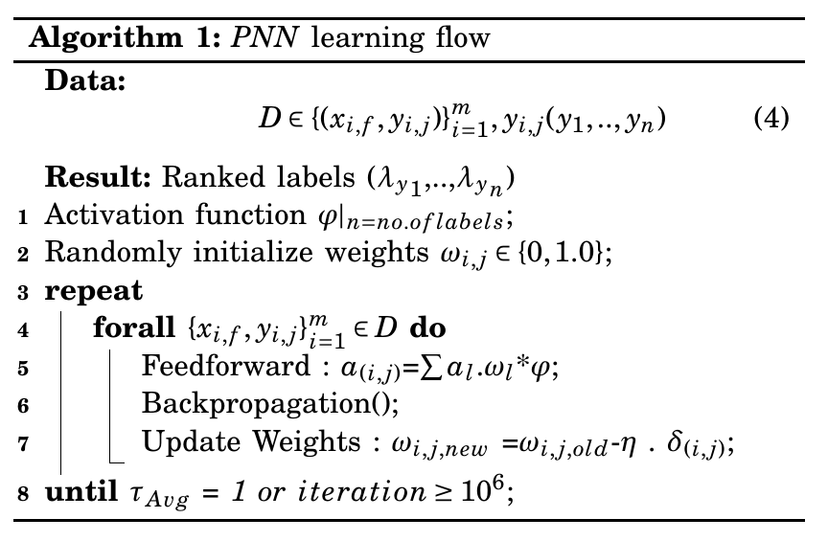
PNN flow

Slide 17
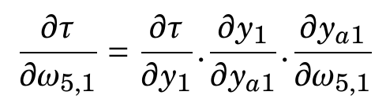
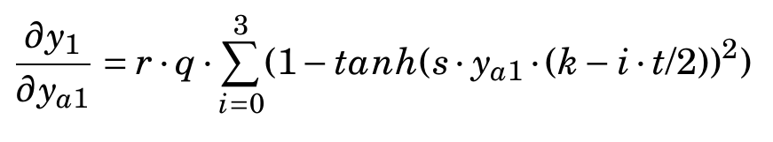
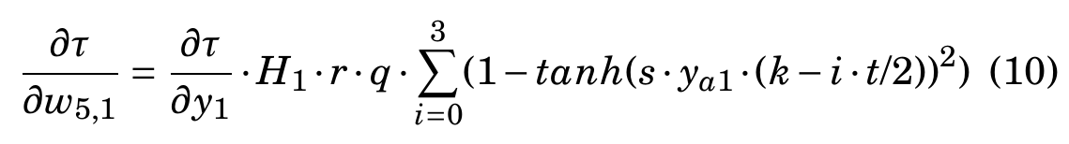

Ranking Example: (5)

Slide 18
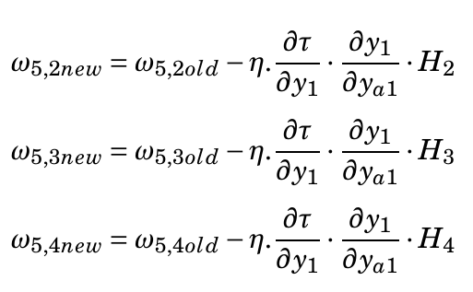
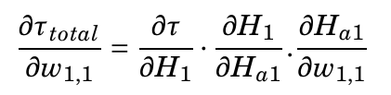
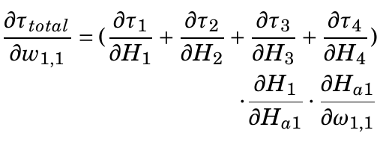
BP of the first layer

Slide 19
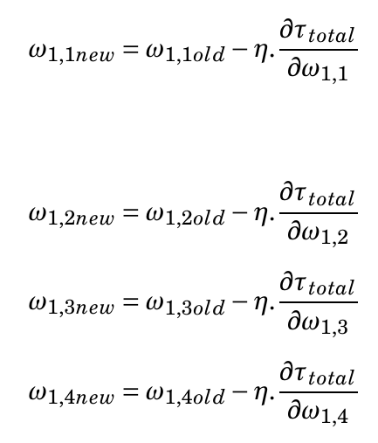
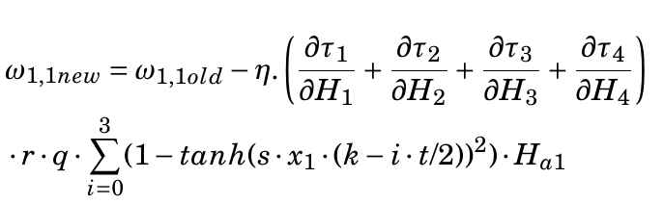

Slide 20
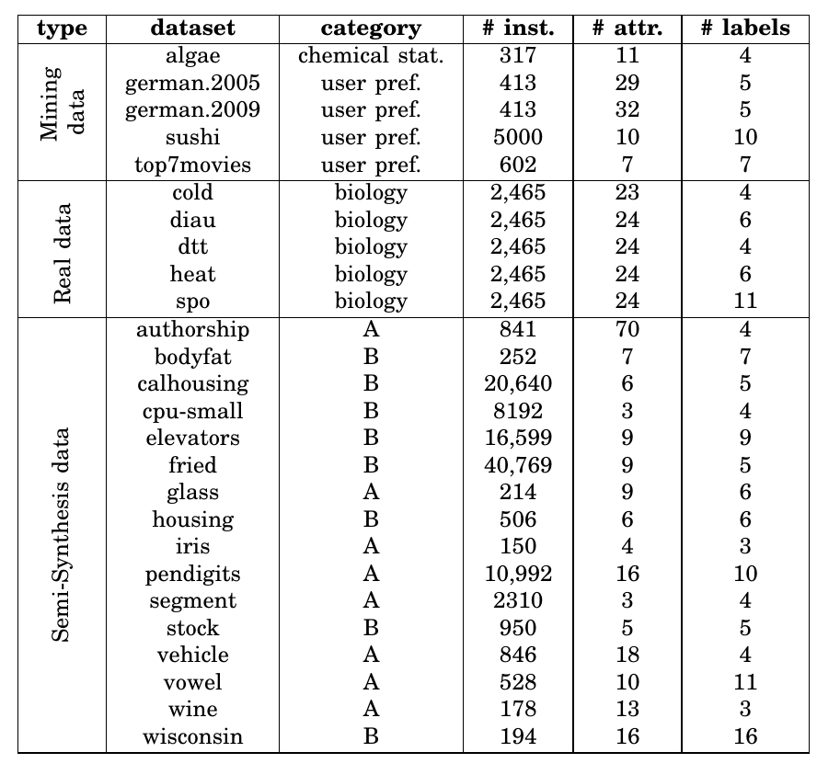
26 Datasets

Slide 21
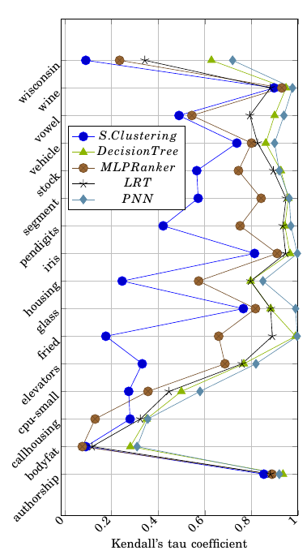
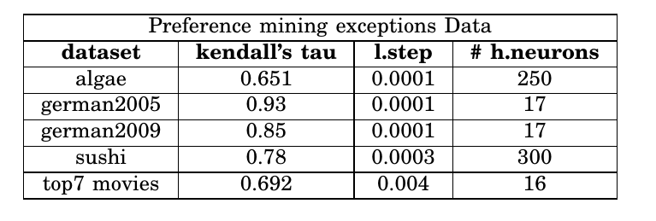
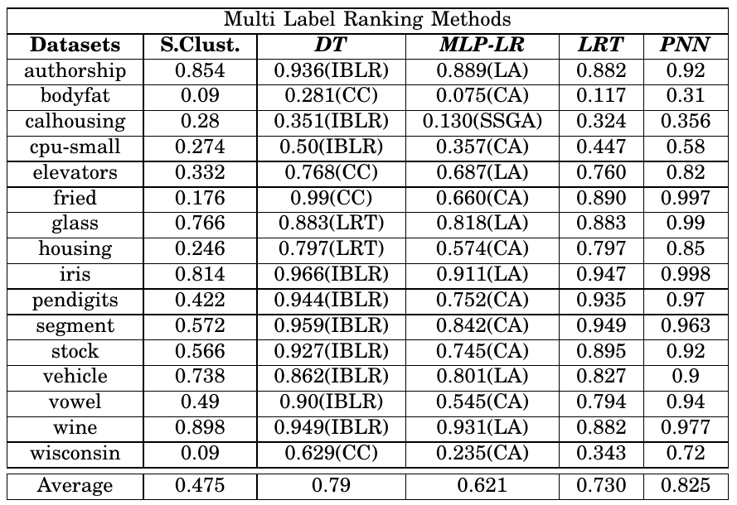
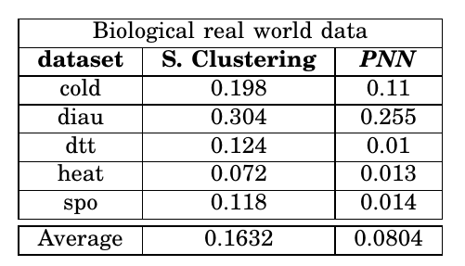
PNN Results

Slide 22
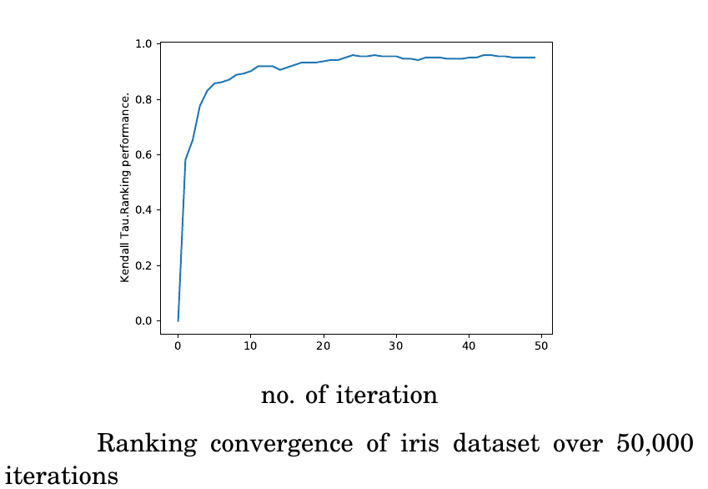
Ranking Convergence

Slide 23
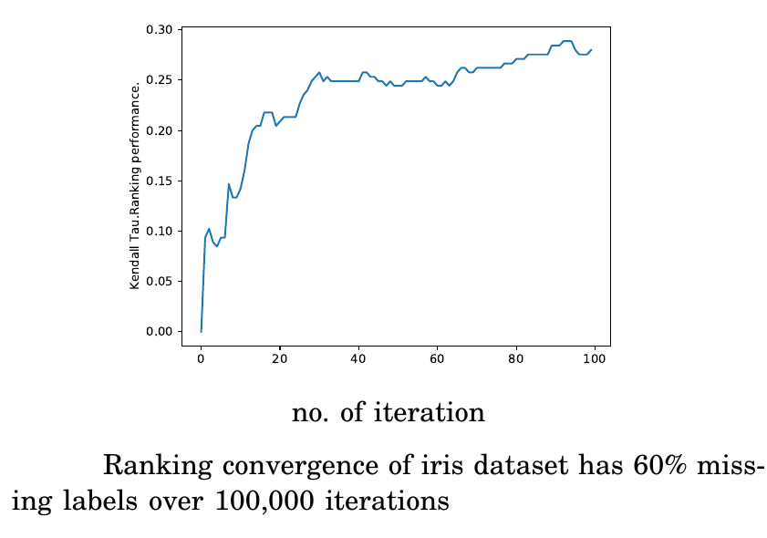
Ranking Convergence with missing data

Slide 24
Future work
- NN Biasing
- Extreme Ranking

Slide 25
Thanks!
Any questions?
Ayman.elgharabawy@uts.edu.au

